Slide 1
@Connect –
Students' Lifetime
Email Service

Slide 2
@Connect-Overview
Student can keep their @Connect account after completed their study in HKUST
Domain part of student’s email address will change to @connect.ust.hk
    Before: @stu.ust.hk for UG / @ust.hk for PG
    After: @connect.ust.hk
  Based on Microsoft’s Office 365 cloud service

Slide 3
Office 365 Features Highlight
Exchange Online
  50GB mailbox - Outlook Web App is our recommended client
Office Web Apps
  Create and edit Office documents from any browsers
SkyDrive Pro
  Provide 25GB of personal storage that syncs with the PC for offline access
  Easily share documents with others
Office 365 Pro Plus (students only)
  Download (subscribe) latest MS Office applications (Word 2013, Excel 2013 etc.) for up to 5 PCs per user
  Office on more devices - iPhones, Android phones and Windows Phones

Slide 4
@Connect Email Address and Routing
Email Address and routing
  Student email address changes to @connect.ust.hk
  Able to send to @connect mailbox with @ust.hk and @stu.ust.hk email alias but not vice versa - for students only
  Email aliases will be removed on graduation
Address rewriting
  The email address is always rewritten in our mail server
  Recipients will always see the email address in correct domain:
    @ust.hk (PG),
    @stu.ust.hk (UG), or
    @connect.ust.hk (PG and UG)

Slide 5
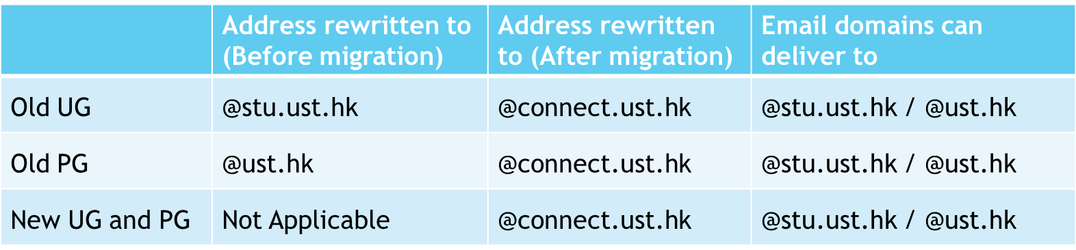
@Connect Email Address and Routing

Slide 6
@Connect Mailbox Lifecycle
Existing students (via opt-in)
  create an empty @connect mailbox and migrate existing mails
  Same account name with student’s existing account
  With @ust.hk / @stu.ust.hk email alias after opt-in
Graduated students - continue to use the service except
  Revoke the Office 365 Pro Plus license
  Removal of @ust.hk / @stu.ust.hk email aliases
Discontinued/Dismissed/Withdrawal students
  @connect mailbox will be disabled and pruned

Slide 7
@Connect Mailbox Migration
@Connect account will be created after 30-45 minutes upon received your migration request
Your email data migration may starts a few hours after you submitted the migration request and it depends on how many migration requests are queued before you
  Email alias @stu.ust.hk / @ust.hk will be setup when data migration has been started, i.e. new incoming email will be delivered to your @Connect account
User can check for migration status
Email message size with attachments that exceed 25MB will not be migrated but copied to the “Un-migrated Items”
Old mailbox access is made available for 3 months after migration (as backup)
Student need to export and import their contacts if necessary

Slide 8
Changes after migrated to @Connect
Students enjoy continuity after graduation
University maintains lifetime connection with students
  Business-class email, calendar and contacts to a user's computer, phone, and web browser
  Increase of email storage (from 4GB to 50GB)
Document sharing via SkyDrive Pro (25GB)
Improved service quality with calendaring, instant messaging, and documents, spreadsheet, and presentation applications
  Office application can install up to 5 PC/Mac
  Office Mobile
Self-service password reset mechanism

Slide 9
Others changes
​​ | ​Outlook Web App | ​HKUST WebMail
Quota​ ​Storage | ​​50 GB | ​4 GB
​Max Outgoing Size | ​25 MB | ​50 MB
​Calendar Support | ​Yes | ​No
​Rich Editing Function e.g. Insert table, image | ​Yes | ​No
Special Folder Name | Sent Items Deleted Items Junk Email | Sent Trash AutoTrash
Email separator when compose message | ; | ,
Recover Deleted Items | Yes | No
Send Signed Email | ​No | ​Yes

Slide 10
Others changes
Cannot read signed email at preview pane, need to open the signed message in separate window.
HKUST Mailing lists will notice your new @connect.ust.hk email address after one hour of the switched over. You will need to use your @Connect email address when using the mailing lists.
Change of Display Name to be available later

Slide 11
Resources for Students
Access from myPortal:
Home tab: Popular Computing Services
Services tab: Computing Services
Upper right corner when @Connect is in production (18 March)
Useful URL:
http://O365.ust.hk (log in)
http://itsc.ust.hk/365migrate/ (migration)
http://itsc.ust.hk/connect/ (@Connect home page)
http://itsc.ust.hk/kb/ (Knowledge Base)
Other Help
at-connect-pilot-adopters-discuss@lists.ust.hk
Computer Barn Helpdesk
cchelp@ust.hk

Slide 12
What you need to complete for this pilot program?
Attend a briefing session
Register and successfully migrate to the @connect account (http://itsc.ust.hk/365migrate/)
Complete an on-line questionnaire

